Slide 1
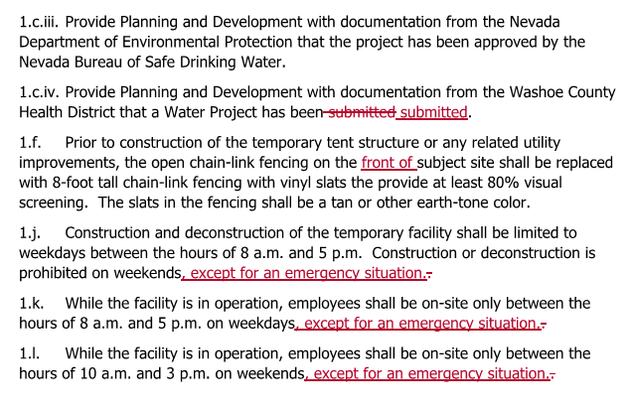
Changes to Conditions of Approval

Slide 2
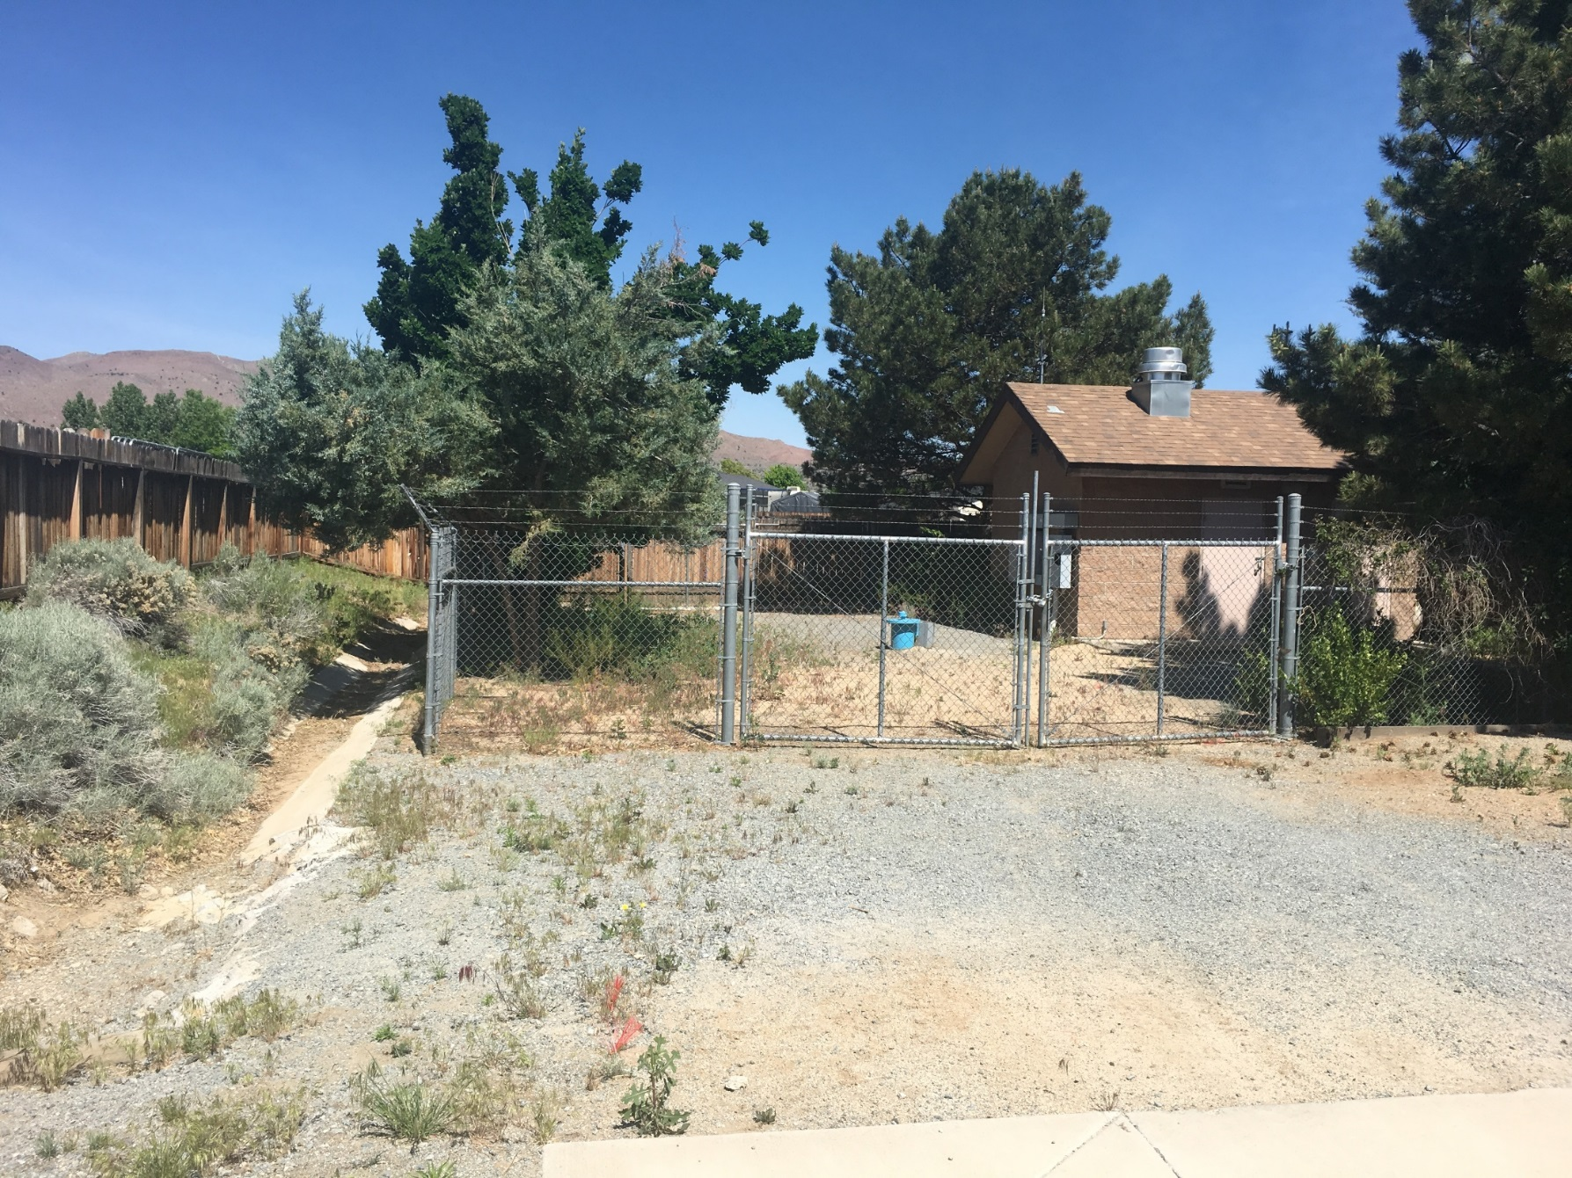
East side fence (front) proposed to be replaced with 8’ tall chain link fence with slats
Front view facing Milke Way

Slide 3
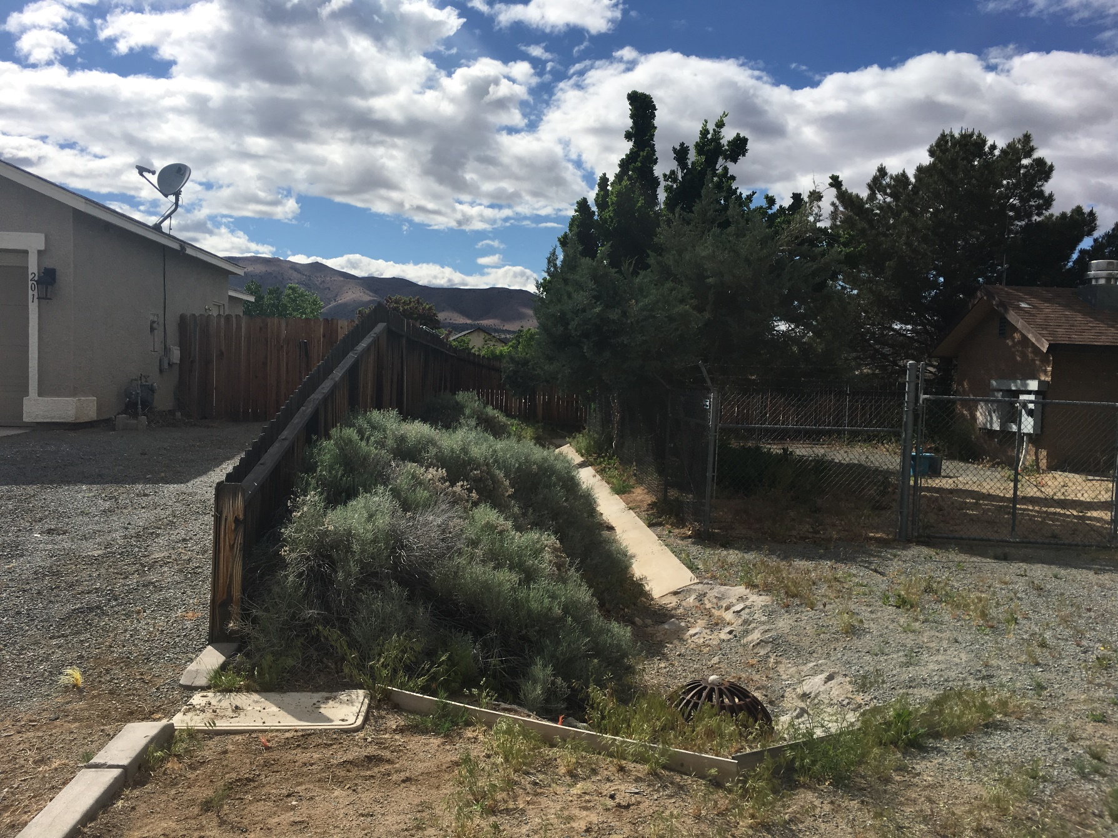
South side fence proposed to remain
South side fence

Slide 4
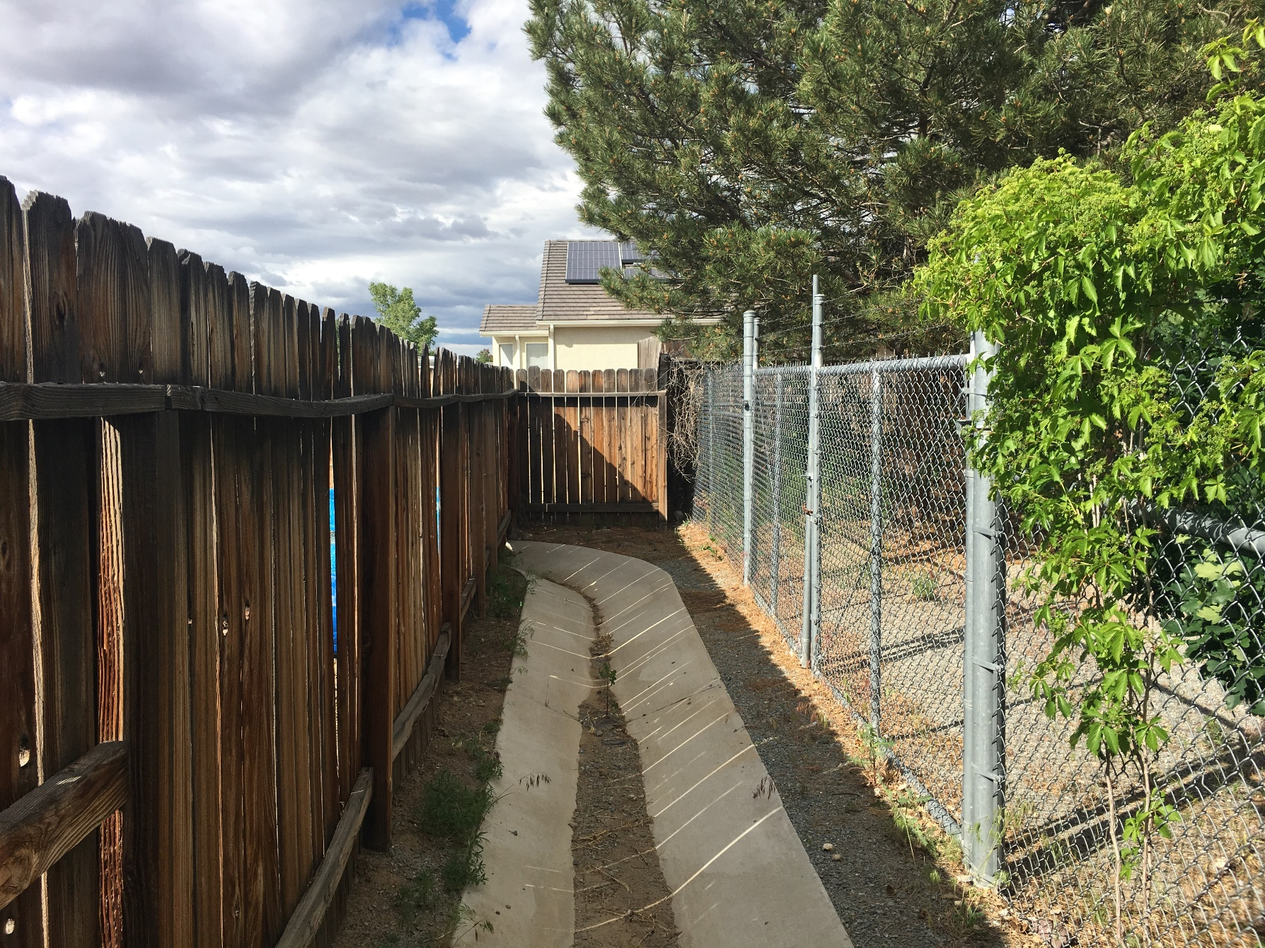
West side fence proposed to remain
West side fence (rear)

Slide 5
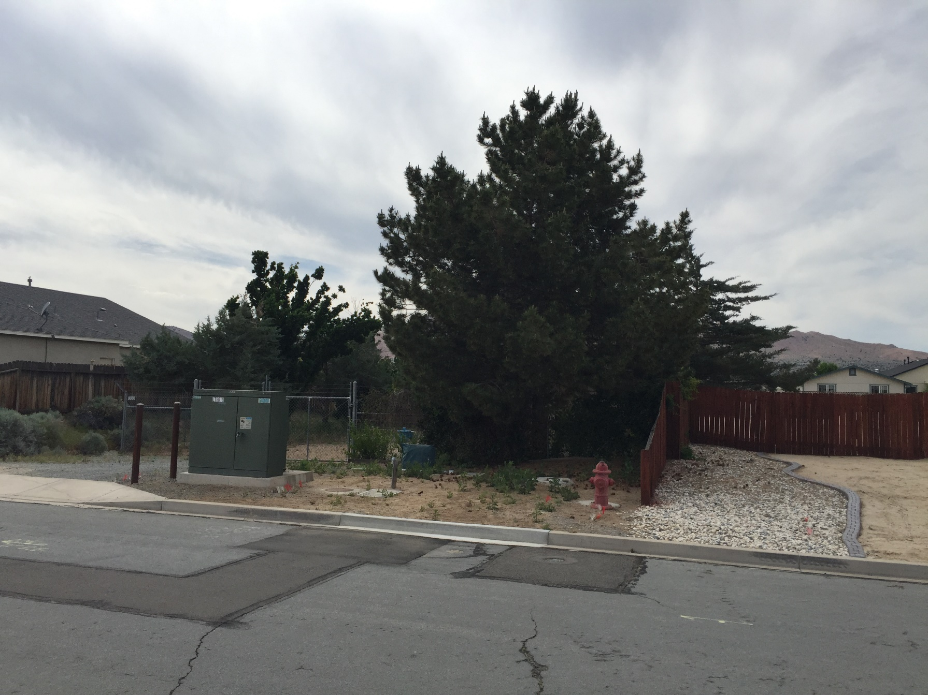
North side fence proposed to remain
North side fence

